Slide 1
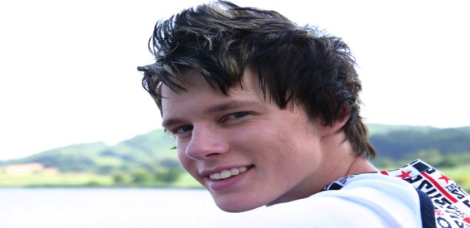
Chris Year 12 Student
“Seeing code come to life is amazing”
Looking for a challenge
Love for coding and figuring out problems
Unsure what to do after high school
Personal Profile
Chris is finishing year 12 and is unsure what to do after high school, let alone what University to attend.
He has a love for robotics and making things to make his life easier, this includes working with PowerShell in windows to help automate daily tasks. He feels this is a path he could be happy with and is constantly reviewing what his career may be.
What Chris wants to find is a site that gets him excited and involved in doing what he loves. He wants to also find out what company's he should be watching or wanting to get employed by. Mostly though he wants to compare himself with people who he feels are “still his age”.
Personal Information
Profession: Student
Location: Darwin, NT
Age: 17
Hobbies: Gaming, surfing the net, robotics
Favorite TV Show: The Walking Dead
Personality: Shy, friendly, inquisitive.
Internet usage
Internet experience: Advanced (Online before School)
Primary Uses: Gaming, chat, videos, email
Favourite Sites: Facebook, YouTube, IGN
Hours online per week: 25-30
Computer: Alienware, ADSL2, Chrome
Study information
Current qualifications: Year 11
Literacy: High Level
IT Skills/knowledge: Very High, able to manipulate OS, basic Linux knowledge, understanding of code.
User Goals
Chris comes to the site to…
Learn more about what others are doing
Find pathways for what to do after year 12
See what level he needs to be at
Find ideas for making things himself
Discover companies in the industry
Business Objectives
We want Chris to…
Visit the site often
Be excited about coding
Be excited about his future
Feel CDU will give him that future
Want to sign up while at CDU
Recommend the site to friends
Review past entries

